Slide 1
Analyzing LA Airbnb Listings
Stella huang
Stats 202a project

Slide 2



Data & prediction
Publically available and web-scraped dataset on Airbnb listings (October 2020)
Goal: predict review ratings (0-100) of listings in West & Central LA
Dataset variables:
Listing
Host
Feature engineered
Price
List of amenities
Geo coordinates
Bath/bed count
Max/max nights
Availability
Ratings
Response rate
Acceptance rate
Verification status
Rental listings
Superhost status
Number of listings within 3 mi
Host age
Time since last review
Region

Slide 3
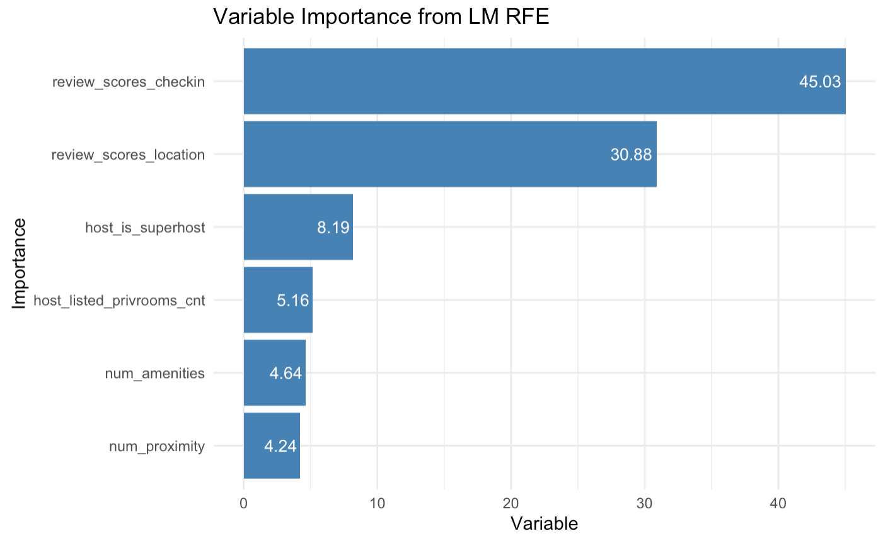
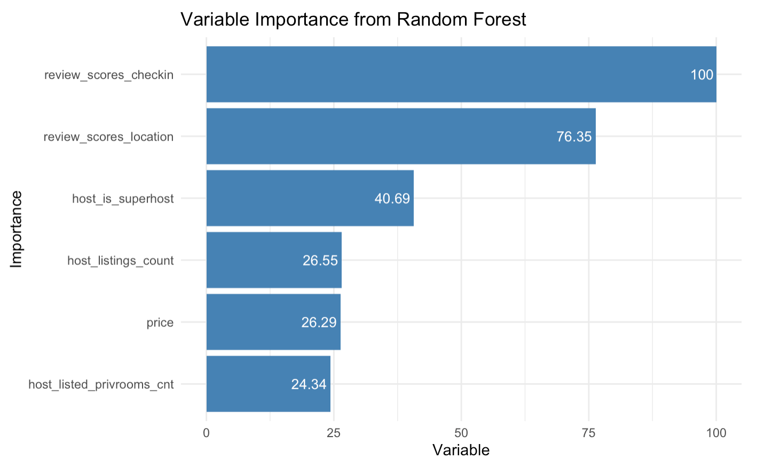
Prediction results
Method | RMSE | Adj. R Sqaured
Linear Regression | 6.180 | 0.584
Step-wise Regression | 6.224 | 0.589
Random Forest | 6.173 | 0.592
recursive feat. elimination performed using linear model
variable importance ranking from random forest

Slide 4
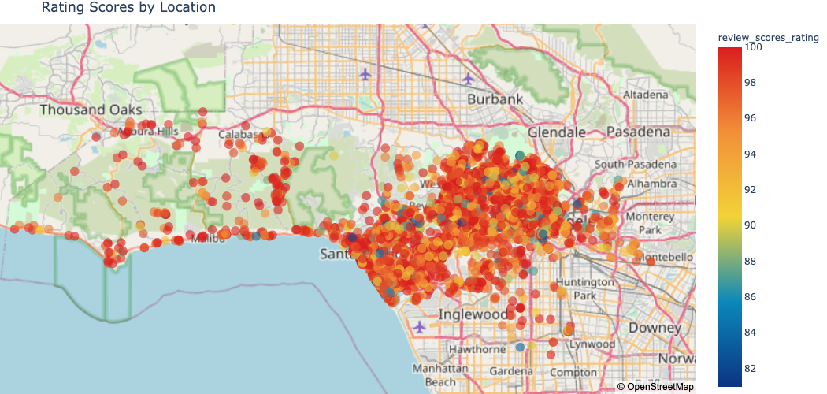
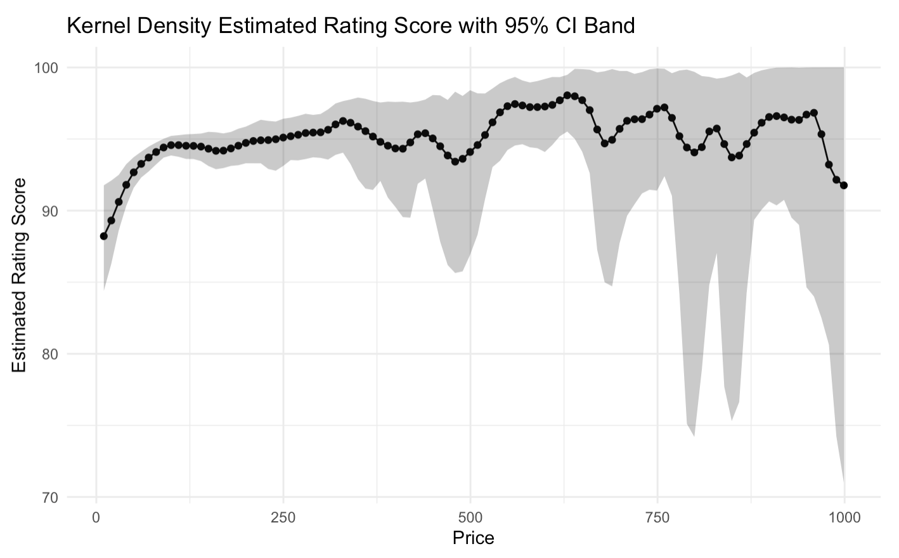
Price vs Rating

Slide 5
Future
Quantify qualitative variables
Feature engineering
property type, amenities
Defect for “anomalies” (outdated listings, unusual listings)
Adjust region of prediction

